Slide 1
Transboundary Conservation Areas
Lesson 1: Introduction and Background to Transboundary Conservation Areas
Notes:
Photo Credit: Landscapes of Dauria (Mongolia) ©Maja Vasilijević
*Note that all of the photos in this presentation are of the Landscapes of Dauria World Heritage Site, Mongolia and Russia. The site is also part of Dauria International Protected Area, shared by China, Mongolia and Russia.
Context and purpose of Lesson 1
This Lesson seeks to introduce the learners to basic concepts in transboundary conservation. The purpose is to:
Help learners understand the nature and general principles of transboundary conservation
Help learners understand why transboundary conservation is important
Get a sense of learners’ experience with transboundary conservation
Provide overview of process covered in the course
Supplemental Reading
IUCN WCPA Best Practice Guidelines Transboundary Conservation: A systematic and integrated approach (Pgs. 2–5)
IUCN Initiating effective transboundary conservation: a practitioner’s guideline based on the experience from the Dinaric Arc (Pgs. 6–11)
IUCN Guidelines for Protected Areas Legislation (PA Guidelines) (Pgs.1–5, 11–14)
IUCN Crossing Borders for Nature (Pgs. 22-25)

Slide 2
Factors of Success
Assess the enabling environment to pursue transboundary conservation
Define the transboundary context and relationships affecting the achievement of the conservation targets and the resulting geographic extent
Identify and involve stakeholders, obtain support of decision makers and ensure political will and buy-in
Agree on common values and joint vision
Determine common transboundary management objectives and develop cooperative agreements
Notes:
Photo Credit: Landscapes of Dauria (Mongolia) ©Maja Vasilijević
Factors of success
Recall the five factors of success in the process of initiating transboundary conservation:
1. Assess the enabling environment to pursue transboundary conservation
2. Define the transboundary context and relationships affecting the achievement of the conservation targets and the resulting geographic extent
3. Identify and involve stakeholders, obtain support of decision makers and ensure political will and buy-in
4. Agree on common values and joint vision
5. Determine common transboundary management objectives and develop cooperative agreements
Lesson 1 will introduce key background, concepts and terminology needed to understand and implement all five factors.

Slide 3
Lesson Overview & Goals
Introduction and Background
Defining transboundary conservation
Importance, benefits and challenges of transboundary conservation
International frameworks and approaches
Overview of the transboundary conservation process
Notes:
Photo Credit: Landscapes of Dauria (Mongolia) ©Maja Vasilijević
Content overview
This Lesson will address:
Defining transboundary conservation
Importance, benefits and challenges of transboundary conservation
International frameworks and approaches
Overview of the transboundary conservation process

Slide 4
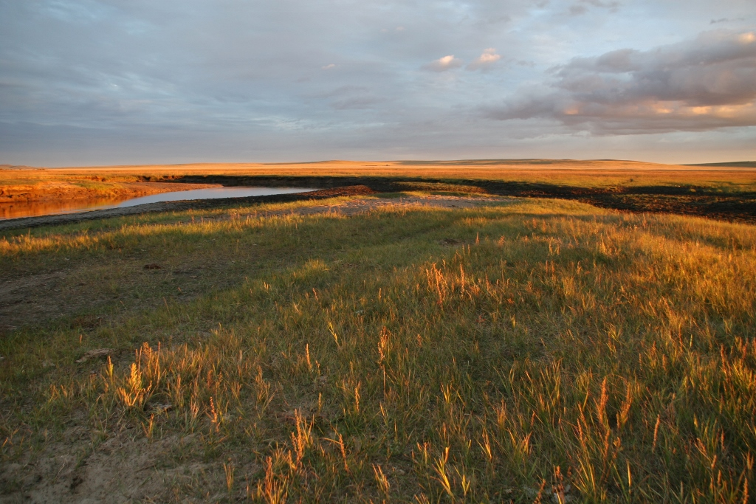

Transboundary Conservation: Defined
What is transboundary conservation? What are some examples?
  …
Notes:
Photo Credit: Landscapes of Dauria (Mongolia) ©Maja Vasilijević
Discussion
Use this slide to start a discussion. Ask learners:
What is transboundary conservation? What does it mean? How would you describe it?
What are some examples of transboundary conservation?
Pause the slideshow and take notes on the slide itself to record learner’s responses. Duplicate the slide if you need more space. Afterwards, responses can be shared with learners.

Slide 5
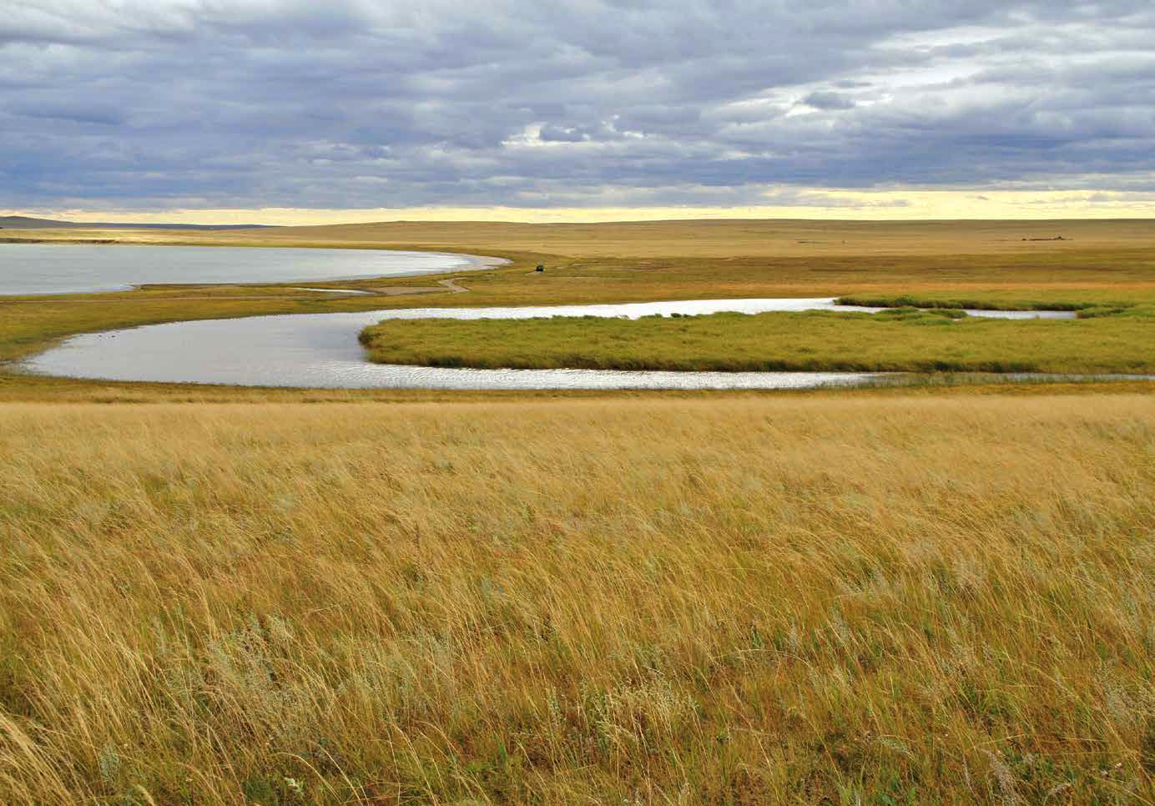
Transboundary Conservation: Defined
Transboundary Conservation:
“A process of cooperation to achieve conservation goals across one or more international boundaries”
Elements of International Cooperation:
Identifying common values and needs concerning shared natural resource
Coordinating (inter)national objectives and management
Improving conservation efforts beyond national boundaries
Harmonizing laws and programmes
Engaging with relevant stakeholders
Developing collaboration among different governance systems
Notes:
Photo Credit: Landscapes of Dauria (Mongolia) ©Maja Vasilijević
Transboundary conservation: Defined
Provide the following definition of transboundary conservation from the IUCN WCPA Best Practice Guidelines: “Transboundary conservation is a process of cooperation to achieve conservation goals across one or more international boundaries.“
Does this match the responses learners gave?
From the definition conclude that transboundary conservation must include:
Cooperation – from relatively simple communication to joint implementation of decisions
International boundaries – adding to the complexity of the process
Conservation objectives – as primary reason for transboundary conservation
Introduce some of the elements of international cooperation:
Identifying common natural values and needs concerning shared natural resources
Coordinating (inter)national regimes’ objectives and management
Improving conservation efforts beyond national boundaries
Harmonizing laws and programmes
Engaging with relevant stakeholders
Developing collaboration among different governance systems

Slide 6
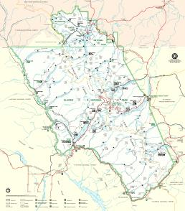
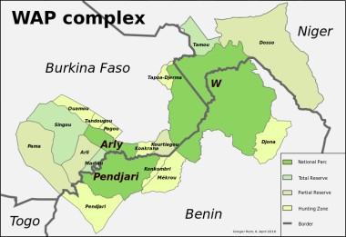
Typology of TBCAs: Examples
Transboundary Protected Area & Park for Peace
Transboundary Conservation Landscape/Seascape
Transboundary Migration Conservation Area
Waterton-Glacier International Peace Park (Canada, USA)
W-Arly-Pendjari Complex (Benin, Burkina Faso, Niger)
Eastern Tropical Pacific Marine Corridor (Colombia, Panama, Ecuador, Costa Rica)
Notes:
Photo Credit: Landscapes of Dauria (Mongolia) ©Maja Vasilijević
Map Credit: Glacier National Park: National Park Service (public domain); Eastern Tropical Pacific Marine Corridor ©Marpelo Foundation; WAP complex ©Gregor Rom (CC BY-SA 4.0)
Typology of TBCAs: Examples
There are three different types of Transboundary Conservation Areas (TBCAs):
Transboundary Protected Areas
Transboundary Conservation Landscapes/Seascapes
Transboundary Migration Conservation Areas
including a Special designation:
Park for Peace
These types will be discussed in more detail in Lesson 2. For now, it is important to emphasize that TBCAs can take many forms.

Slide 7
Importance and Benefits
What are the benefits of transboundary conservation?
  …
Notes:
Photo Credit: Landscapes of Dauria (Mongolia) ©Maja Vasilijević
Discussion
Use this slide to start a discussion. Ask learners to brainstorm:
What are the benefits of transboundary conservation?
Process:
If there is time, ask learners to write down benefits on cards. Then have each participant share answers.
Option 1: Pause the slideshow and take notes on the slide itself to record learner’s responses. Duplicate the slide if you need more space. Afterwards, responses can be shared with learners.
Option 2: Tape the cards learners have filled out onto the wall or a board.
Option 3: Take notes on a flipchart of whiteboard.
After brainstorming, evaluate the answers. What types of benefits did they identify?
Tell them briefly about the following types of benefits:
Ecological
Socio-economic
Cultural
Management
Political
Did they think of benefits in each of these types? If not, are there any they want to add? Then go onto the next slides, which describe different types of benefits in detail.

Slide 8


Importance and Benefits
Ecological Benefits
Improving ecological integrity
Strengthening ecosystem resilience
Securing long term survival of species
Facilitating reintroduction or natural recolonization of species
Enabling larger species dispersal
Best Practice Guidelines:
Case studies 2, 10, Boxes 5, 10
Notes:
Photo Credit: Landscapes of Dauria ©UNESCO / Evgeniy Kokukhin
Importance and benefits
Transboundary conservation generates ecological benefits.
TBCAs improve ecological integrity. This describes the health of the ecosystem and the ability to support biodiversity. Ecological integrity requires preservation of natural components, including native species, geological formations, water, and ecosystem processes. TBCAs support building ecological integrity by increasing the size of the area under conservation management, reducing fragmentation and integrating ecosystem processes and drivers such as fire, natural flow regimes and natural grazing regimes.
TBCAs strengthen ecosystem resilience in the face of climate change. Resilience means the ability of an ecosystem to survive and adapt to threats and pressures like climate change, wildfires, and human-caused degradation. Larger, healthier and more well-connected ecosystems are more resilient.
TBCAs help secure long term survival of species, by supporting ecosystem integrity and resilience and ensuring larger areas of protection. TBCAs can particularly support migratory species.
Similarly, TBCAs can facilitate reintroduction or natural recolonization of species, by ensuring protection on both sides of a border and supporting species that currently only survive in isolated patches.
Likewise, TBCAs enable larger species dispersal, fighting fragmentation and allowing species to have larger ranges which improves the health, resilience and integrity of populations.
Examples of benefits of TBCAs can be found in the IUCN WCPA Best Practice Guidelines, which may be distributed as handouts.
Box 5 on p. 23 shows transboundary conservation efforts to expand habitat, enable species dispersal, and ensure long term survival of a critically endangered gibbon between China and Vietnam
Case study 2 on p. 25 describes how transboundary conservation protects Andean flamingos in South America
Box 10 on p. 36 is an example of transboundary conservation to secure long term survival of tiger populations in the Indo-Bhutan Manas Tiger Conservation Landscape
Case study 10 on p. 87 is an example of transboundary cooperation to improve ecological integrity of forest ecosystems in the Sangha Trinational in the Congo Basin
Alternatively, provide a case study from the participants’ region.

Slide 9
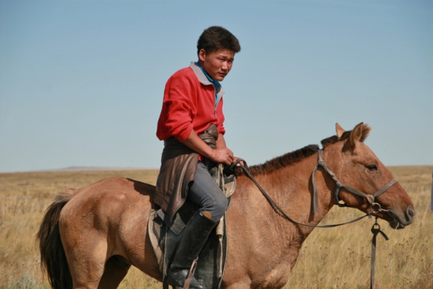
Importance and Benefits
Socio-economic Benefits
Strengthening social relations and trust
Supporting transboundary trade of local products
Facilitating nature-based transboundary tourism
Enabling common marketing
Promoting sustainable use
Assisting sustainable development of borderlands and improving local economy
Providing opportunities for co-funded projects
Best Practice Guidelines:
Box 8, Case study 5
Notes:
Photo Credit: Landscapes of Dauria (Mongolia) ©Maja Vasilijević
Importance and benefits
Transboundary conservation creates social and economic benefits.
Transboundary conservation can strengthen social relations and trust across borders. Cooperation towards a common conservation goal can develop friendly relationships among neighbouring communities.
Transboundary conservation can spur broader cooperation that facilitates movement and transboundary trade of local products.
Transboundary cooperation can facilitate nature-based transboundary tourism. Tourists travelling to different parts of a transboundary area to have different experiences, to view different natural features and spend money in different countries and regions of the area can bring benefits to all countries concerned.
Countries involved in transboundary cooperation can work together to enable common marketing of tourism attractions or other sustainable goods or services from the area. This can increase sustainable revenue for communities along the border.
Transboundary conservation can help ensure resources along the border are used sustainably. Sustainable use ensures economic development that can be counted on in the long term.
Transboundary trade, tourism, and other sustainable activities facilitated by transboundary conservation can assist in sustainable development of the borderlands and improve local economies.
Transboundary cooperation can create more opportunities for jointly developed and co-funded projects.
Examples of benefits of TBCAs can be found in the IUCN WCPA Best Practice Guidelines, which may be distributed as handouts.
Box 8 on p. 28 gives an example of sustainable tourism development in the Kavango Zambezi Transfrontier Conservation Area
Case Study 5 on p. 37 describes how transboundary ecotourism can support socio-economic development and job creation in the /Ai/Ais Richtersveld Transfrontier Park
An additional example is found in Crossing Borders for Nature:
The Pasvik-Inari Case Study starting on p. 22 describes development of infrastructure and education and common marketing on the Trilateral Park between Finland, Norway and Russia
Alternatively, provide a case study from the participants’ region.

Slide 10
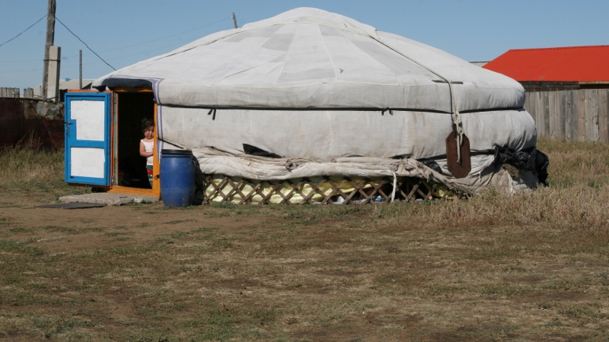
Importance and Benefits
Cultural Benefits
Recognizing cultural heritage and spiritual values
Enhancing cultural significance of nature by bringing divided cultures back together
Supporting linkages between nature and Indigenous Peoples and traditional local communities
Preserving historical transboundary landscapes
Best Practice Guidelines:
Box 9, Case studies 3, 4
Notes:
Photo Credit: Landscapes of Dauria (Mongolia) ©Maja Vasilijević
Importance and benefits
Many protected areas and wider conservation areas have significant spiritual and cultural values. Transboundary conservation can help support and protect those values.
Transboundary conservation can help in recognition of cultural heritage and spiritual values. Different cultures place values on natural features of the environment that have great meaning and importance for them. Conservation areas can also be appreciated by people who do not necessarily share these value systems but still recognize and respect these places as symbols of identity or sites of inspiration.
Cultural heritage features can be divided by political boundaries. Transboundary conservation initiatives may help revive these links, to enhance the cultural significance of nature by bringing divided cultures back together.
Linkages between traditional communities and indigenous peoples and nature can benefit from transboundary conservation.
Transboundary conservation can help preserve historical transboundary landscapes that provide insights into older ways of life.
Examples of benefits of TBCAs can be found in the IUCN WCPA Best Practice Guidelines, which may be distributed as handouts.
Box 9 on p. 30 shows ways traditional knowledge can support conservation in the Altai-Sayan ecoregion across China, Kazakhstan, Mongolia and Russia
Case Study 3 on p. 31 gives an example of a Sacred Landscape in the Hindu Kush Himalaya
Case Study 4 on p. 33 describes how engaging communities divided by a border can support transboundary conservation, and vice versa
Alternatively, provide a case study from the participants’ region.

Slide 11
Importance and Benefits
Benefits for Day-to-Day Management and Research
Enhancing efficiency of day-to-day management of shared issues, e.g.: sharing equipment, joint patrols and cooperation in wildfire management, ecosystem restoration, search and rescue operations, and control of invasive species
Supporting coordinated capacity development for protected area staff
Promoting dynamic problem-solving
Enabling exchange of knowledge, information and expertise
Facilitating joint research and harmonized monitoring of species and habitats
Supporting integrated management and development of common conservation strategies
Best Practice Guidelines: Case studies 5, 9, Boxes 6, 16
Notes:
Photo Credit: Landscapes of Dauria (Mongolia) ©Maja Vasilijević
Importance and benefits
Transboundary conservation can benefit day-to-day management of shared ecosystems and research opportunities.
TBCAs can enhance efficiency of day-to-day management of shared issues. This can include sharing equipment, organizing joint patrols to combat poaching and illegal wildlife trade, cooperating in wildlife management, ecosystem restoration, search and rescue, and invasive species control, etc. Such cooperation can reduce costs of management.
TBCAs can support coordinated capacity building, for example through exchanges between protected area staff, or organisation of joint capacity development programmes.
Working together can promote dynamic problem-solving, spurred by different perspectives.
Exchange of knowledge, information and expertise in the TBCA can help improve management and outcomes.
TBCAs can facilitate joint research and joint monitoring of species and habitats, which can reduce costs and improve conservation outcomes and research results.
Transboundary cooperation can support integrated management and development of common strategies for conservation.
Examples of benefits of TBCAs can be found in the IUCN WCPA Best Practice Guidelines, which may be distributed as handouts.
Case study 5 on p. 37 gives an example of coordinated capacity building of protected area staff through development training and workshops in the /Ai/Ais Richtersveld Transfrontier Park.
Case study 9 on p. 77 describes sharing of information and best practices in the Grenadines Network of MPAs
Box 6 on p. 24 discusses joint patrols between the protected areas in Nigeria and Cameroon to save the endangered Cross River gorilla
Box 16 on p. 67 shows cooperation in research, information sharing, and management in the Emerald Triangle between Cambodia, Laos and Thailand.
Alternatively, provide a case study from the participants’ region.

Slide 12
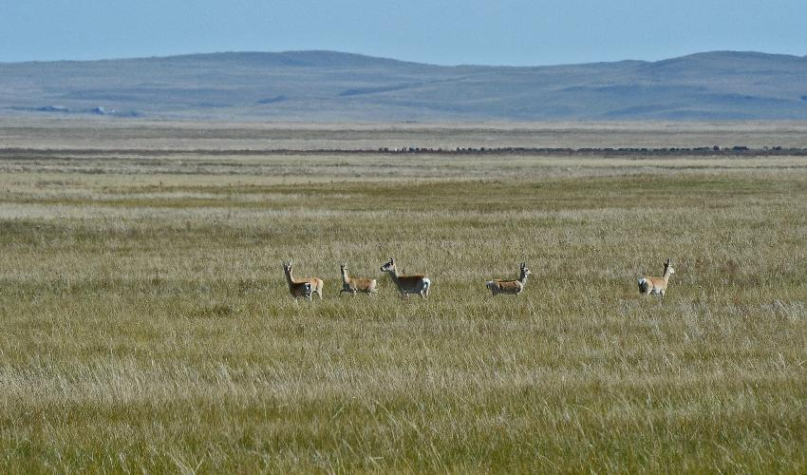
Importance and Benefits
Political Benefits
Enhanced cooperation and diplomacy
Potential harmonisation of legal and policy frameworks
Enabling foundation from which good political relations, stability and peace are secured
Best Practice Guidelines:
Boxes 11, 12
Notes:
Photo Credit: Dzeren Mongolian gazelles, Daursky State Nature Biosphere Reserve ©IUCN / Wendy Strahm
Importance and benefits
Transboundary conservation has great potential to help improve political relations between sovereign countries.
Transboundary conservation and related cooperation can demonstrate political goodwill and lead to enhanced cooperation and diplomacy. In regions where social glue is lost due to ethnic cleansing, TBCAs in the form of Parks for Peace can help overcome this.
Transboundary conservation can also support harmonisation of legal and policy frameworks for conservation between countries. Involvement in a transboundary initiative can support learning and cooperation leading to legal reform.
Transboundary cooperation can create an enabling foundation from which good political relations, stability and peace are secured. It can promote stability between new countries and countries with contested borders.
Examples of benefits of TBCAs can be found in the IUCN WCPA Best Practice Guidelines, which may be distributed as handouts.
Box 11 on p. 40 gives an example of a transboundary cooperation initiative that led to coordinated legal frameworks and policy cooperation in the Alps
Box 12 on p. 41 describes how transboundary conservation in the Dinarides region in South-Eastern Europe supported regional stability following conflict
Alternatively, provide a case study from the participants’ region.

Slide 13
Challenges in Transboundary Conservation
What are the challenges in transboundary conservation?
  …
Notes:
Photo Credit: Landscapes of Dauria (Mongolia) ©Maja Vasilijević
Now that benefits have been addressed, move on to challenges.
Discussion
Use this slide to start a discussion. Ask learners to brainstorm:
What are the main challenges for transboundary conservation? What makes transboundary conservation difficult?
Process
If there is time, ask learners to write down challenges on cards. Then have each participant share answers.
Option 1: Pause the slideshow and takes notes on the slide itself to record learner’s responses. Duplicate the slide if you need more space. Afterwards, responses can be shared with learners.
Option 2: Tape the cards learners have filled out onto the wall or a board.
Option 3: Take notes on a flipchart of whiteboard.
After brainstorming, discuss the answers. How many agree with each challenge? Have any participants experienced these challenges? How did they overcome them?

Slide 14
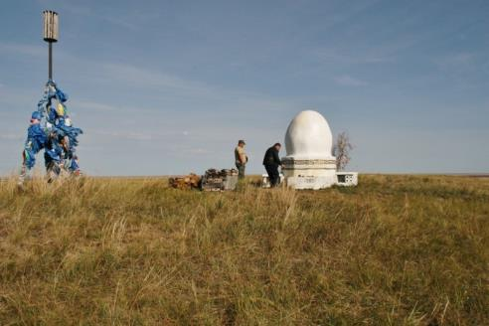
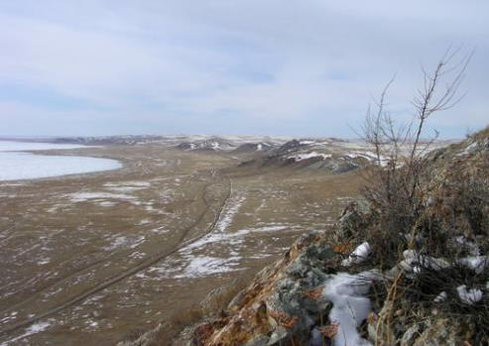
Challenges in Transboundary Conservation
Different languages
Cultural differences
Political indifference
Differences in law
Different levels of economic development
Unequal resources and capacity
Unequal professional standards
Undetermined vision and intangible goals
Poor communication
Lack of commitment
Lack of cooperative spirit
Need for increased coordination
Inaccessible terrain
Notes:
Photo Credit: Landscapes of Dauria (Russia) ©Maja Vasilijević (top); Landscapes of Dauria: Winter in the Daursky Reserve (the northern shore of Zun-Torey lake) ©V.Kirilyuk (bottom)
Challenges in transboundary conservation
There can be many challenges in transboundary conservation. The following are some that may be common:
Different languages
Cultural differences
Political indifference
Differences in law
Different level of economic development
Unequal resources & capacity
Unequal professional standards
Undetermined vision and intangible goals
Poor communication
Lack of commitment
Lack of cooperative spirit
Need for increased coordination
Inaccessible terrain – e.g. mountainous landscape
Use this slide to check against the answers from the last slide.
Did the participants brainstorm any challenges that are not mentioned here?
Are there any challenges here that the participants did not think of? Do they seem familiar to any of the participants?

Slide 15
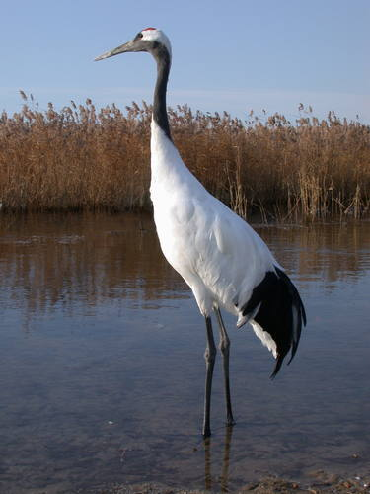
International Frameworks and Approaches
International Designations
Ramsar Convention
  Consultation regarding transboundary wetlands
  Guidelines for international cooperation on transboundary wetlands
  Integrated River Basin Management approach
UNESCO World Heritage Convention
  Nominated properties may be transboundary and serial
  Joint management committee or similar body
UNESCO Man and the Biosphere Programme
  Recommendations for Transboundary Biosphere Reserves
Notes:
Photo Credit: Landscapes of Dauria ©UNESCO / O. Goroshko
International frameworks and approaches
When engaging in a Transboundary Conservation Initiative, reference to relevant international and regional frameworks may help in obtaining buy-in by elevating the international importance of the initiative, and may open additional sources of funding, e.g. from framework bodies such as MEA secretariats or from multilateral sources such as GEF.
There are a number of international designations that promote, recognise and enable transboundary conservation approaches. In addition to providing an impetus to transboundary conservation, these designations provide important guidance and standards which can promote sustainability.
Ramsar Convention
“The Contracting Parties shall consult with each other about implementing obligations arising from the Convention especially in the case of a wetland extending over the territories of more than one Contracting Party or where a water system is shared by Contracting Parties. They shall at the same time endeavour to coordinate and support present and future policies and regulations concerning the conservation of wetlands and their flora and fauna.” (Art. 5).
Guidelines for international cooperation providing for transboundary wetlands and river systems, extending to formal joint management arrangements or collaboration in the development and implementation of a management plan for the site (Ramsar COP 1999 VII.19).
Integrated River Basin Management approach comprises transboundary issues.
UNESCO World Heritage Convention
A nominated property may occur on the territory of States Parties having adjacent borders (UNESCO WHC Operational Guidelines 2013).
Wherever possible, transboundary nominations should be prepared and submitted by States Parties jointly, and it is recommended that States Parties establish a joint management committee or similar body to oversee management (UNESCO WHC Operational Guidelines 2013).
*Note that according to the IUCN definitions of types of TBCAs, all of the following may be considered as TBCAs:
- Transboundary World Heritage Sites (as per UNESCO 2013)
- Serial transnational World Heritage Sites (as per UNESCO 2013)
- Single World Heritage Sites located in two or more countries and which have on-going programmes of cooperation.
UNESCO Man and the Biosphere Programme
Seville Strategy for Biosphere Reserves (1995) calls for increased attention to Transboundary Biosphere Reserves.
Pamplona Recommendations for Transboundary Biosphere Reserve (2000).

Slide 16

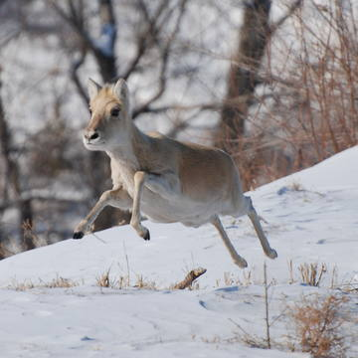

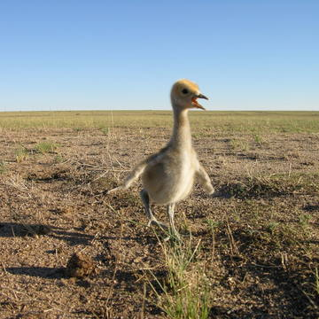
International Frameworks and Approaches
Convention on Biological Diversity - Programme of Work on Protected Areas (PoWPA)
Ecosystem approach in transboundary context
  Establish regional networks of TBPAs
Convention on Migratory Species (CMS)
  Cooperation among range states
  List of migratory species
Notes:
Photo Credit: Landscapes of Dauria ©UNESCO / O. Goroshko (owl top left); Landscapes of Dauria ©UNESCO / V. Kirilyuk (Hedgehog bottom left); Landscapes of Dauria ©UNESCO / A. Dambain (bottom right); Landscapes of Dauria ©UNESCO / V. Kirilyuk (top right)
International frameworks and approaches
International frameworks and guidelines
CBD Programme of Work on Protected Areas
“the establishment and management of protected area systems in the context of the ecosystem approach should not simply be considered in national terms, but where the relevant ecosystem extends beyond national boundaries, in ecosystem or bioregional terms as well” (CBD COP 2004 VII/28).
Called on Parties to establish and strengthen regional networks of TBPAs and to cooperate with neighbouring countries to establish an enabling environment for TBPAs.
Convention on Migratory Species
Obligation to protect threatened migratory species, including through cooperation among range states.
List of migratory species that are threatened with extinction (Appendix I) and that would significantly benefit from international cooperation (Appendix II).

Slide 17
Regional Programmes and Frameworks
Regional Frameworks
Southern African Development Community (SADC)
  Leads regional efforts to establish Transfrontier Conservation Areas (TFCAs)
  Regional network of TFCA practitioners
EU Natura 2000 Network
  Sites established under Birds Directive and Habitats Directive
  Focus on habitats that cross international borders
International Centre for Integrated Mountain Development (ICIMOD)
  Eight member countries of the Hindu Kush Himalaya
  Transboundary Landscapes Programme supports conservation and sustainable use
  Transboundary conservation initiatives in six transboundary landscapes
Notes:
Regional programmes and frameworks
In addition to global approaches, there are many regional agreements and programmes that support TBCAs.
This slide provides some examples of regional programmes and frameworks. The instructor may substitute with frameworks from the target region, if they exist.
The Southern African Development Community (SADC)
Defines Transfrontier Conservation Area as: “the area or component of a large ecological region that straddles the boundaries of two or more countries, encompassing one or more protected areas as well as multiple resource use areas”
Since 1999, leads regional transboundary efforts together with Peace Parks Foundation
In 2013, TFCA Programme established a regional network of TFCA practitioners
For more information, visit: https://www.sadc.int/themes/natural-resources/transfrontier-conservation-areas/
The Natura 2000 network
Network of sites for conservation of species and habitats across the European Union
Special Protected Areas are created under Birds Directive
Special Areas of Conservation are created under Habitats Directive
Not explicitly transboundary, but focuses on habitats that cross borders, and requires strong international conservation
Includes a number of TBCAs
The International Centre for Integrated Mountain Development (ICIMOD) supports transboundary conservation among the eight countries of the Hindu Kush Himalaya
Transboundary Landscape Programme supports development of conservation and sustainable use initiatives at the landscape level
As of 2018, ICIMOD identified six transboundary landscapes and established transboundary conservation initiatives in the Kailash Sacred Landscape, Kangchenjunga, Hindu Kush Karakoram Pamir, and the Far Eastern Himalayas
For more information, see http://www.icimod.org/?q=rps_landscapes
Also see Case Study 3 on p. 31 for a description of the Kailash Sacred Landscape

Slide 18
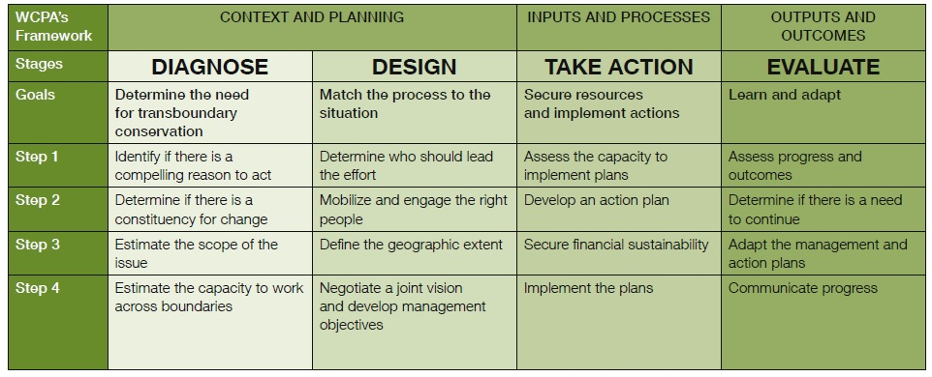
Overview: Transboundary Conservation Process
Notes:
Overview: Transboundary conservation process
The final section of this lesson will discuss the transboundary conservation process, and give an overview of what will be covered in this Module. This is based on the WCPA framework for transboundary conservation.
This module focuses on initiating transboundary conservation. It will cover the Context and Planning part of the process, including:
Stage 1: Diagnose
Stage 2: Design
It may be helpful to print out this diagram as a handout.
The following slides provide more information on the different stages.

Slide 19
Overview: Transboundary Conservation Process
Context and Planning
Diagnose: Determining the need for TBCAs
  Identify a compelling reason to act
  Determine if there is a constituency for change
  Estimate the scope
  Estimate the capacity to work across borders
Design: Match the process to the situation
  Determine leadership
  Mobilize public
  Define the geographic extent
  Negotiate a joint vision and develop management objectives
Notes:
Photo Credit: Landscapes of Dauria (Mongolia) ©Maja Vasilijević
Overview: Transboundary conservation process
This module focuses on the “Context and Planning” part of the transboundary conservation process, for initiating transboundary conservation.
The first stage in initiating transboundary conservation is “Diagnose”.
The goal of this stage is to determine the need for transboundary conservation.
It includes four steps:
Identify if there is a compelling reason to act (Note that ‘compelling reason to act’, as defined in Glossary, indicates a reason or motive that is convincing enough to undertake transboundary conservation and engage in transboundary cooperation)
Determine if there is a constituency for change (Note that a ‘constituency for change’, as defined in Glossary, indicates a critical mass of people who are aware of a common challenge and ready to work together in response)
Estimate the scope of the issue
Estimate the capacity to work across borders
In Lesson 3, learners will have a chance to practice using the Diagnostic Tool developed by IUCN WCPA for diagnosing the need for TBCAs.
The second stage in initiating transboundary conservation is “Design”.
The goal of this stage is to match the process to the situation.
It includes four steps:
Determine who should lead the effort
Mobilize and engage the right people
Define the geographic extent
Negotiate a joint vision and develop management objectives
Lesson 5 will focus on the first three steps of this stage, and includes an exercise on defining the geographic extent and mapping stakeholders.
Lesson 7 will focus on the fourth step, and includes a mock negotiation of a joint vision and management objectives.
The other lessons in this module will address key substantive concepts relating to models of transboundary cooperation, governance, and management of TBCAs.

Slide 20
Overview: Transboundary Conservation Process
Inputs and Processes
Outputs and Outcomes
Take action: Secure resources and implement actions
Assess the capacity to implement plans
Develop an action plan
Secure financial resources
Implement the plans
Evaluate: Learn and adapt
Assess progress and outcomes
Determine if there is a need to continue
Adapt the management and action plans
Communicate progress
Notes:
Photo Credit: Landscapes of Dauria (Mongolia) ©Maja Vasilijević
Overview: Transboundary conservation process
This slide shows the next stages in the transboundary conservation process:
The “Take action” stage constitutes the “Inputs and processes” part of the WCPA framework.
The goal of this stage is to secure resources and implement actions.
The steps include:
Assess the capacity to implement plans
Develop an action plan
Secure financial resources
Implement the plans
The “Outputs and Outcomes” part of the framework includes the stage “Evaluate”
The goal of the stage is to learn and adapt
The steps include:
Assess progress and outcomes
Determine if there is a need to continue
Adapt the management and action plans
Communicate progress
These stages are not addressed in detail in this module. Lesson 8 gives an overview of these stages as part of the discussion of next steps.

Slide 21
Discussion
What current or proposed Transboundary Conservation Areas are you involved in? What are the challenges? What are the real or potential benefits?
  …
Notes:
Photo Credit: Landscapes of Dauria (Mongolia) ©Maja Vasilijević
Discussion
Use this slide to start a discussion.
Ask learners about their experience with transboundary conservation.
What is your experience establishing or working in TBCAs?
What were the challenges?
What were the benefits?
If learners do not have direct experience with transboundary conservation, instead ask:
What is your interest in transboundary conservation?
What do you see as the benefits?
What challenges can you foresee?
Process:
Option 1: Ask learners in advance to prepare a slide on a site in which they worked. Include the slides in this presentation.
Option 2: Go around the room and ask each learner to describe an area in which they worked. Make notes on this slide, or on a whiteboard or flipchart.
Questions and answers
Following the discussion, ask learners if they have any questions on the lesson, or on anything the other learners have said.

Slide 22
Transboundary Conservation Areas
End of Lesson 1
Notes:
Photo Credit: Landscapes of Dauria (Mongolia) ©Maja Vasilijević

